Slide 1

Inappropriate Comments Scanner
CSE-Data Science
Adithya Singh (217Z1A6702)
Ch. Harini Reddy (217Z1A6713)
N.Hema Narendra Reddy (217Z1A6743)
GUIDE NAME
Mr. S. Ravi Teja

Slide 2


OVERVIEW
Abstract
Existing System
Proposed System
Algorithms
Flowchart
Design
Modules
Conclusion

Slide 3



ABSTRACT
Problem Statement: Traditional methods for filtering inappropriate comments rely on static keyword-based approaches, leading to inefficiencies.
Solution: AI-powered classification using Bidirectional LSTM and TextVectorization improves accuracy and real-time adaptability.
Benefits: Efficient detection, scalability, real-time moderation, and context-aware filtering.

Slide 4



EXISTING SYSTEM
Manual Moderation: Requires human effort, time-consuming, and inconsistent.
Keyword-Based Filtering: Ineffective against context-based toxicity and leads to false positives.
Limitations: Lacks adaptability, poor handling of evolving slang and nuanced language.

Slide 5



PROPOSED SYSTEM
AI-Based Classification: Uses LSTM with optimized data pipelines for efficient comment classification.
Real-Time Processing: Deployable on cloud platforms for scalable performance.
Improved Accuracy: Robust training with labeled datasets ensures precise classification.

Slide 6
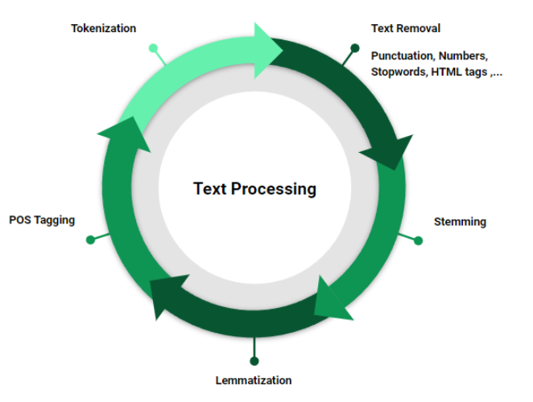
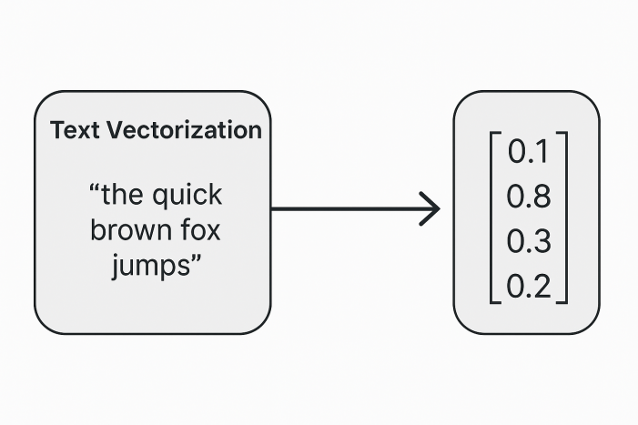
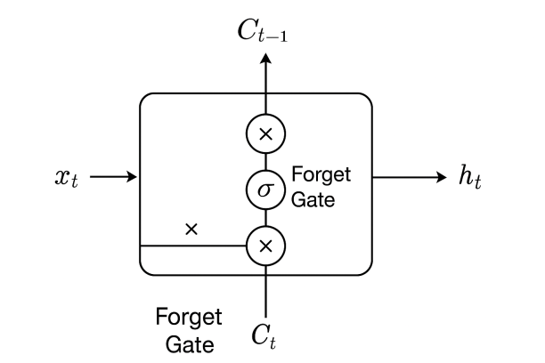
ALGORITHMS
Bidirectional LSTM: Captures context from both previous and upcoming words, improving classification.
TextVectorization: Converts text into numerical data for efficient processing.
Preprocessing Techniques: Tokenization, stopword removal, and normalization enhance accuracy.

Slide 7
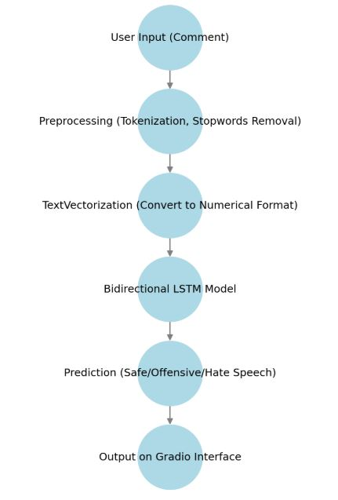
FLOWCHART

Slide 8






DESIGN
Frontend
(Gradio UI)
Backend
(Python, TensorFlow)
USER
Database
(MySQL, MongoDB)
API
(REST API, JSON)
Cloud Services
(AWS, Google Cloud)

Slide 9






MODULES
Data Collection & Preprocessing
Inference & API
User Interface (Gradio)
Database (MySQL, MongoDB)
Model Training & Optimization

Slide 10
Source Code
0. Install Dependencies and Bring in Data
!pip install tensorflow pandas matplotlib sklearn
import os
import pandas as pd
import tensorflow as tf
import numpy as np
df = pd.read_csv('train.csv')
df.head()
1. Preprocess
!pip list
from tensorflow.keras.layers import TextVectorization
X = df['comment_text']
y = df[df.columns[2:]].values
MAX_FEATURES = 2000 # number of words in the vocab
vectorizer = TextVectorization(max_tokens=MAX_FEATURES,
output_sequence_length=1800,
output_mode='int')

Slide 11
vectorizer.adapt(X.values)
vectorized_text = vectorizer(X.values)
#MCSHBAP - map, chache, shuffle, batch, prefetch from_tensor_slices, list_file
dataset = tf.data.Dataset.from_tensor_slices((vectorized_text, y))
dataset = dataset.cache()
dataset = dataset.shuffle(160000)
dataset = dataset.batch(16)
dataset = dataset.prefetch(8) # helps bottlenecks
train = dataset.take(int(len(dataset)*.7))
val = dataset.skip(int(len(dataset)*.7)).take(int(len(dataset)*.2))
test = dataset.skip(int(len(dataset)*.9)).take(int(len(dataset)*.1))
2. Create Sequential Model
from tensorflow.keras.models import Sequential
from tensorflow.keras.layers import LSTM, Dropout, Bidirectional, Dense, Embedding
model = Sequential()
# Create the embedding layer
model.add(Embedding(MAX_FEATURES+1, 32))
# Bidirectional LSTM Layer
model.add(Bidirectional(LSTM(32, activation='tanh')))

Slide 12
# Feature extractor Fully connected layers
model.add(Dense(128, activation='relu'))
model.add(Dense(256, activation='relu'))
model.add(Dense(128, activation='relu'))
# Final layer
model.add(Dense(6, activation='sigmoid'))
model.compile(loss='BinaryCrossentropy', optimizer='Adam')
model.summary()
history = model.fit(train, epochs=1, validation_data=val)
from matplotlib import pyplot as plt
plt.figure(figsize=(8,5))
pd.DataFrame(history.history).plot()
plt.show()
3. Make Predictions
input_text = vectorizer('You freaking suck! I am going to hit you.')
# Reshape input_text to have the expected shape (1, 1800)
input_text = input_text.numpy().reshape(1, -1)
# Convert to Tensorflow Tensor
input_text = tf.convert_to_tensor(input_text)
res = model.predict(input_text)

Slide 13
4. Evaluate Model
from tensorflow.keras.metrics import Precision, Recall, CategoricalAccuracy
pre = Precision()
re = Recall()
acc = CategoricalAccuracy()
for batch in test.as_numpy_iterator():
# Unpack the batch
X_true, y_true = batch
# Make a prediction
yhat = model.predict(X_true)
# Flatten the predictions
y_true = y_true.flatten()
yhat = yhat.flatten()
pre.update_state(y_true, yhat)
re.update_state(y_true, yhat)
acc.update_state(y_true, yhat)
print(f'Precision: {pre.result().numpy()}, Recall:{re.result().numpy()}, Accuracy:{acc.result().numpy()}')

Slide 14
5. Test and Gradio
!pip install gradio jinja2
import tensorflow as tf
import gradio as gr
model.save('toxicity.keras')
model = tf.keras.models.load_model('toxicity.keras')
input_str = vectorizer('hey i freaken hate you!')
res = model.predict(np.expand_dims(input_str,0))
res
def score_comment(comment):
vectorized_comment = vectorizer([comment])
results = model.predict(vectorized_comment)
text = ''
for idx, col in enumerate(df.columns[2:]):
text += '{}: {}\n'.format(col, results[0][idx]>0.5)
return text
interface = gr.Interface(fn=score_comment,
inputs=gr.inputs.Textbox(lines=2, placeholder='Comment to score'),
outputs='text')
interface.launch(share=True)

Slide 15
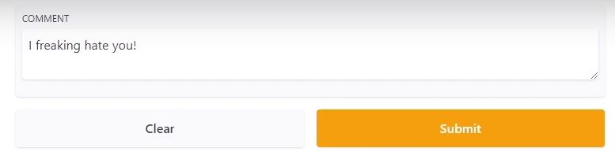
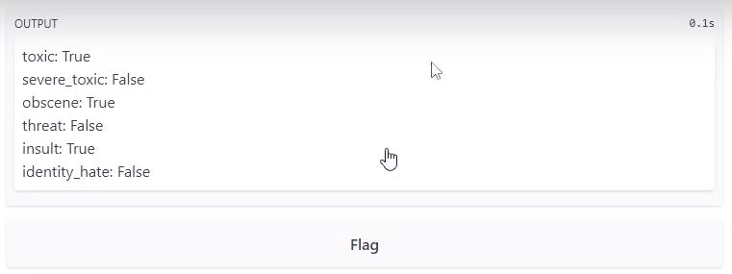
OUTPUT

Slide 16



CONCLUSION
Key Achievements: Efficient and scalable AI-based moderation.
Performance Enhancements: LSTM + TextVectorization improve accuracy.
Future Scope: Integration with social media platforms, multilingual support, and improved contextual understanding.

Slide 17
THANK YOU

